Slide 1
Advanced Topics in Data Mining
Instructor:
Dr. Hamid Turab Mirza
Department of Computer Science
CUI, Lahore

Slide 2
DATA

Slide 3
Outline
Introduction
Attributes, Data Sets, and Data Storage
Values, Features, and Objects
Data Sets
Data Storage: Databases and Data Warehouses
  Data storage and data mining
Issues Concerning the Amount and Quality of Data
  High dimensionality
  Dynamic data
  Imprecise, Incomplete, and Redundant data
  Missing values and Noise

Slide 4
Introduction
Data mining and KDP results depend on the quality and quantity of data
  we focus on three issues: data types, data storage techniques, and amount and quality of the data
  the above constitutes necessary background for the KDP steps

Slide 5
Attributes, Data Sets, and Data Storage
Data have diverse formats and are stored using a variety of different storage modes
  a single unit of information is a value of a feature/attribute, where each feature can take on a number of different values
  objects, described by features, are combined to form data sets, which are stored as flat files or in other formats in databases and data warehouses

Slide 6
Attributes, Data Sets, and Data Storage
values
numerical: 0, 1, 5.34, -10.01
symbolic: Yes, two, Normal, male
features
sex: values ∈{male, female}
blood pressure: values ∈ [0, 250]
chest pain type: values ∈{1, 2, 3, 4}
objects
set of patients
data set (flat file)
objects | features and values
patient 1: male, 117.0, 3
patient 2: female, 130.0, 1
patient 3: female, 102.0, 1
……
database
Denver clinic
data warehouse
three heart clinics
database
San Diego clinic
database
Edmonton clinic

Slide 7
Values, Features, and Objects
The key types of values are:
  numerical values are expressed by numbers
    for instance real numbers (-1.09, 123.5), integers (1, 44, 125), prime numbers (1, 3, 5), etc.
  symbolic values usually describe qualitative concepts
    colors (white, red) or sizes (small, medium, big)

Slide 8
Values, Features, and Objects
Features described by numerical and symbolic values can be either discrete (categorical) or continuous
  Discrete features concern a situation in which the total number of values is relatively small (finite)
    a special case of a discrete feature is binary feature, with only two distinct values
  Continuous features concern a situation in which the total number of values is very large (infinite) and covers a specific interval/range
  Nominal feature implies that there is no natural ordering between its values, while an ordinal feature implies some ordering
  values for a given feature can be organized as sets, vectors, or arrays

Slide 9
Values, Features, and Objects
Objects (records, examples, units, cases, individuals, data points)
represent entities that are described by one or more features
  multivariate data - where objects are described by many features
  univariate data – where objects are described by a single feature

Slide 10
Values, Features, and Objects
Example: patients at a heart disease clinic
  Object “patient” is described by name, sex, age, diagnostic test results such as blood pressure, cholesterol level, and diagnostic evaluation like chest pain type (severity)
name: Konrad Black
sex: male
age: 31
blood pressure: 130.0
cholesterol
in mg/dl: 331.2
chest pain type: 1
patient Konrad Black (object)
symbolic nominal feature
symbolic binary feature {male, female} set
numerical discrete ordinal feature {0, 1, …, 109, 110} set
numerical continuous feature [0, 200] interval
numerical continuous feature [50.0, 600.0] interval
numerical discrete nominal feature {1, 2, 3, 4} set

Slide 11
Data Sets
Objects described by the same features form data sets
  many DM tools assume that data sets are organized as flat files, stored in a 2D array comprised of rows and columns, where
    rows represent objects
    columns represent features
  flat files store data in a text file format, and are often generated from spreadsheets or databases

Slide 12
Data Sets
Example of patient data at a heart disease clinic
notice new feature type: date (numeric/symbolic)
NULL value indicates that the corresponding feature value is unknown (not measured, or missing)
several objects relate to the same patient (Konrad Black, Magda Doe)
for Anna White, the cholesterol value is 45.0, which is outside of the interval defined as acceptable for this feature (so it is incorrect)
Name | Age | Sex | Blood pressure | Blood pressure test date | Cholesterol in mg/dl | Cholesterol test date | Chest pain type | Defect type | Diagnosis
Konrad Black | 31 | male | 130.0 | 05/05/2005 | NULL | NULL | NULL | NULL | NULL
Konrad Black | 31 | male | 130.0 | 05/05/2005 | 331.2 | 05/21/2005 | 1 | normal | absent
Magda Doe | 26 | female | 115.0 | 01/03/2002 | NULL | NULL | 4 | fixed | present
Magda Doe | 26 | female | 115.0 | 01/03/2002 | 407.5 | 06/22/2005 | NULL | NULL | NULL
Anna White | 56 | female | 120.0 | 12/30/1999 | 45.0 | 12/30/1999 | 2 | normal | absent
… | … | … | … | … | … | … | … | … | …

Slide 13
Data Sets
There are three popular flat file data repositories:
  http://www.ics.uci.edu/~mlearn/ (Machine Learning repository)
  http://kdd.ics.uci.edu/ (Knowledge Discovery in Databases archive)
  http://lib.stat.cmu.edu/ (StatLib repository)
All provide free access to numerous data sets often used for benchmarking purposes
  data are posted with results of their analysis

Slide 14
Data Storage: Databases and Data Warehouses
DM tools can be used on a variety of other than flat files data formats such as
  databases
  data warehouses
  advanced database systems
    object-oriented and object-relational database
    data-specific databases, such as transactional, spatial, temporal, text, or multimedia databases
  World Wide Web (WWW)

Slide 15
Data Storage: Databases and Data Warehouses
Why to use database systems?
  The flat file may not fit into the memory of a computer
  DM methods need to work on many different subsets of data and therefore a data management system is required to efficiently retrieve the required pieces of data
  Data may need to be dynamically added and updated, often by different people in different locations, and at different times
  Flat file may include redundant information, which can be avoided if data are stored in multiple tables

Slide 16
Data Storage: Databases and Data Warehouses
Data Base Management System (DBMS)
  consists of a database that stores the data and a set of programs for management and fast access to the data
  It provides services like
    ability to define the structure (schema) of the database
    ability to store the data, to access the data concurrently, and have data distributed/stored in different locations
    ensures security (to protect against an unauthorized access or the system crash)

Slide 17
Databases
The most common DB type is a relational database, which consists of a set of tables
  each table is rectangular and can be perceived as a single flat file
  tables consist of attributes (columns, fields) and tuples (records, rows)
  each table has a unique name, and each record is assigned a special attribute (known as a key) that defines unique identifiers
  It includes the Entity-Relational Data (ER) model, which defines a set of entities (tables, records, etc.) and their relationships

Slide 18
Databases
Relational database
using multiple
tables results in
removal of redundant
information present
in the flat file
the data are divided
into smaller blocks
that are easier to
manipulate and that fit
into memory
patient
Patient ID | Name | Age | Sex | Chest pain type | Defect type | Diagnosis
P1 | Konrad Black | 31 | male | 1 | normal | absent
P2 | Magda Doe | 26 | female | 4 | fixed | present
P3 | Anna White | 56 | female | 2 | normal | absent
… | … | … | … | … | … | …
blood_pressure_test
Blood pressure test ID | Patient ID | Blood pressure | Blood pressure test date
BPT1 | P1 | 130.0 | 05/05/2005
BPT2 | P2 | 115.0 | 01/03/2002
BPT3 | P3 | 120.0 | 12/30/1999
… | … | … | …
cholesterol_test
Cholesterol test ID | Patient ID | Cholesterol in mg/dl | Cholesterol test date
SCT1 | P1 | 331.2 | 05/21/2005
SCT2 | P2 | 407.5 | 06/22/2005
SCT3 | P3 | 45.0 | 12/30/1999
… | … | … | …
performed_tests
Patient ID | Blood pressure test | Cholesterol test
P1 | BPT1 | SCT1
P2 | BPT2 | SCT2
P3 | BPT3 | SCT3
… | … | …

Slide 19
Databases
DBMS uses a specialized language: SQL (Structured Query Language)
SQL provides fast access to portions of the entire database
  For example we may want to extract information about tests performed between specific dates
    this is simple with SQL while with a flat file the user has to manipulate the data himself to extract the desired portion of data

Slide 20
Data Warehouses
The main purpose of a DB is data storage, while the main purpose of a data warehouse is data analysis
  data warehouse is organized as a set of subjects of interest
      such as patients, test types, or diagnoses
  analysis is done to provide information from a historical perspective
      for instance we ask for a breakdown of the most often performed clinical tests over the last five years
    such requests/queries require availability of summarized information
      For instance a DW may store the number of tests performed by each clinic, during a month, for a specific patient age intervals

Slide 21
Data Warehouses
Data warehouse for the heart disease clinics
database
Denver heart clinic
clean
transform
integrate
load
(update)
Client A
data warehouse
query
database
San Diego heart clinic
query
database
Edmonton heart clinic
Client B

Slide 22
Data Warehouses
DW usually uses a multidimensional database structure
  each dimension corresponds to an attribute or a set of attributes
  each cell (value) in the database corresponds to some summarized (aggregated) measure, such as average, etc.
  the implementation of a DW can be as a relational database or a multidimensional data cube
    the cube is a 3D view of the data and allows for fast access

Slide 23
Data Warehouses
Data cube for the heart disease clinics
  3D: clinic (Denver, San Diego, Edmonton), time (in months), and age range (0-8, 9-21, 21-45, 45-65, over 65)
    each dimension can be summarized, e.g., we can collapse months into quarters
  values are in thousands and show how many blood pressure tests were performed
TIME
there were 8,000 blood pressure tests done in Edmonton clinic in June 2005 for patients over 65 years old
33 27 43 37 18
24 25 35 26 21
June
May
April
March
February
January
10 17 28 27 8
14 15 28 16 9
11 21 33 12 21
12 32 45 22 14
12 19 48 29 11
9 22 38 9 19
2nd quarter
1st quarter
CLINICS
Denver
San Diego
Edmonton
AGE RANGE
0-8 9-21 21-45 45-65 >65

Slide 24
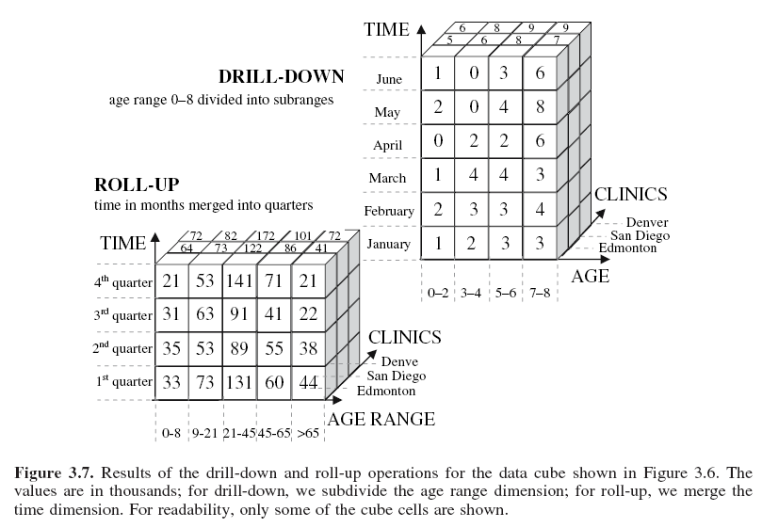

Slide 25
Advanced Data Storage
Relational databases/warehouses are often used by retail stores/banks.
More advanced DBMS have emerged to satisfy users who need to handle more complex data; they store and manipulate data such as:
  transactional
  spatial data
  hypertext
  multimedia data
  temporal data
  the WWW content
    They utilize efficient data structures and methods for handling operations on the more complex data.

Slide 26
Advanced Data Storage
Object-oriented databases are based on the object-oriented programming paradigm, which treats each stored entity as an object
  object encapsulates a set of variables (its description), a set of messages that the object uses to communicate with other objects, and a set of methods that contain code that implement the messages
  similar (the same) objects are grouped into classes, and are organized in hierarchies
    For instance, the patient class would have variables name, address, and sex, while its instances would be particular patients
      patient class could have a subclass of “retired patient”, which inherits all variables of the patient class but also have new variables such as date of the home release

Slide 27
Advanced Data Storage
Transactional databases consist of records that represent transactions
    a transaction includes unique identifier and a set of items that make up the transaction
      an example is a record of a purchase in a store
      the difference between the relational and the transactional database is that the latter stores a set of items, rather than a set of values of the related features
        they are used to identify sets of items that frequently co-exist in transactions
sales
Transation ID | Set of item IDs
TR000001 | Item1, Item32, Item52, Item71
TR000002 | Item2, Item3, Item4, Item57, Item 92, Item93
… | …

Slide 28
Advanced Data Storage
Spatial databases handle spatially-related data, such as geographical maps, satellite images, or medical images
  spatial data can be represented in two ways
    in a raster format
    in a vector format
    Raster format uses n dimensional pixel maps, while the vector format requires representing all objects as simple geometrical objects, such as lines, and uses vectors to compute relations between the objects

Slide 29
Advanced Data Storage
Temporal (time-series) databases extend the relational database to handle time-related features
  attributes may be defined using timestamps like days and months, or hours and minutes, etc.
  the database keeps time-related features by storing sequences of their values that change with time
    a relational database usually stores the most recent values only

Slide 30
Advanced Data Storage
Text databases include features (attributes) that use word descriptions of objects
    sentences or paragraphs of text
      unstructured like sentences written in plain language (English, Polish, Spanish, etc.)
      semistructured where some words or parts of the sentence are annotated (like drug’s name and dose)
      structured where all the words are annotated (physician’s diagnosis may use a fixed form that lists specific drugs and doses)
    they require special tools and integration with text data hierarchies, such as dictionaries, thesauruses, and specialized term-classification systems (such as those used in medicine)

Slide 31
Advanced Data Storage
Multimedia databases allow storage, retrieval and manipulation of image, video, and audio data
  the main concern for such data sources is their very large size
    both video and audio data are recorded in real-time, and thus the database must include mechanisms that assure a steady and predefined rate of acquisition to avoid gaps, system buffer overflows, etc.

Slide 32
Advanced Data Storage
WWW is an enormous distributed repository of data linked together via hyperlinks
    hyperlinks link individual data objects of different types together allowing for an interactive access
    most specific characteristic of the Web is that the users seek information by traversing between objects via links
    WWW uses specialized query engines such as Google and Yahoo!

Slide 33
Advanced Data Storage
Heterogeneous databases consist of a set of interconnected databases that communicate between themselves to exchange the data and provide answers to user queries
    the biggest challenge is that the objects in the component databases differ substantially, which results in difficulties in developing common semantics facilitating communication between them

Slide 34
Data Storage and Data Mining
Data Mining vs. Utilization of a Data Storage
  DW and DB users often understand data mining as an execution of a set of the OLAP commands
    data or information retrieval should not be confused with data mining
  data mining provides more complex techniques for understanding data and generating new knowledge
    it allows for semi-automated discovery of patterns and trends
      for instance, learning that increased blood pressure over a period of time leads to certain heart defects

Slide 35
Issues of the Amount and Quality of Data
Several issues related to the data have significant impact on the quality of the outcome of a KDP:
  huge and highly dimensional volume of data, and the problem of DM methods scalability
  dynamic nature of the data – data are constantly being updated/changed
  problems related to data quality, such as imprecision, incompleteness, noise, missing values, and redundancy

Slide 36
High Dimensionality
Among many DM tools available only some are “truly” being able to mine high-dimensional data
to handle massive amount of data that requires the algorithms to be scalable
scalability is not related to efficient storage and retrieval (these belong to DBMS) but to the algorithm design
  systems that are not capable of handling large quantities of data are known as machine learning or statistical data analysis systems

Slide 37
High Dimensionality
Is it a real problem?
  analysis of data from large retail stores goes into hundreds of millions of objects, while in bioinformatics data are described by thousands of features (e.g., microarray data)
  large commercial databases now average about one PB of objects

Slide 38
High Dimensionality
Three “dimensions” of high-dimensionality need to be addressed
  The number of objects, which may range from a few hundred to a few billion
  The number of features, which may range from a few to several thousand
  The number of values a feature assumes, which may range from 1-2 to a few million

Slide 39
High Dimensionality
The ability of a particular DM algorithm to cope with highly dimensional data is described by its asymptotic complexity
  it estimates the total number of operations, which translates into the specific amount of run time
  it describes the growth rate of the algorithm’s run time as the size of each dimension increases
  the most commonly used complexity analysis describes scalability with respect to the number of objects

Slide 40
High Dimensionality
To illustrate:
Assume the user wants to generate knowledge in terms of production rules using either a decision tree or a rule algorithm:
  Proprietary See5 alg. has log-linear complexity, i.e., O(n*log(n)), n is the number of objects
  DataSqueezer alg. has log-linear complexity, i.e., O(n*log(n))
  CLIP4 alg. has quadratic complexity, i.e., O(n²)
  C4.5 rules alg. has cubic complexity, i.e. ,O(n³)

Slide 41
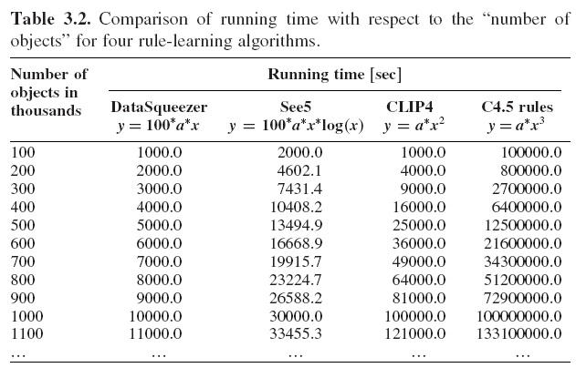

Slide 42
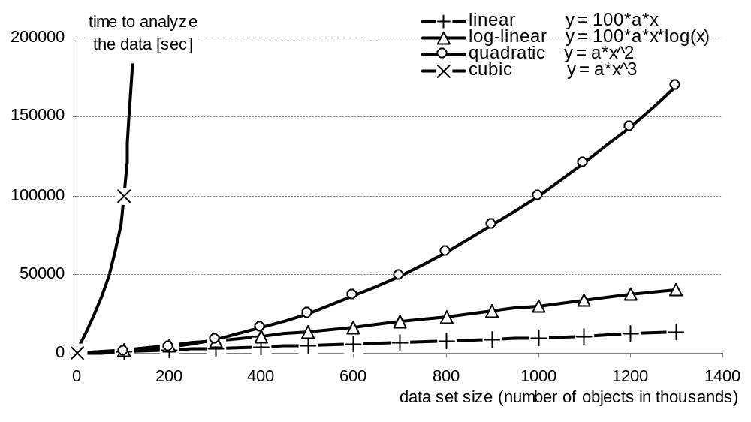
High Dimensionality
This example illustrates the importance of asymptotic complexity
for 100 objects the linear algorithm computes the results in 1,000 seconds, while the cubic algorithm in 100,000 seconds (using previous formulas)
when the number of objects increases 10x (to 1000) the time to compute the results for the linear algorithm increases to 10,000 seconds, and to 100,000,000 seconds for the cubic algorithm

Slide 43
High Dimensionality
Two techniques can be used to improve scalability:
  speeding up the algorithm
    achieved through the use of heuristics, optimization, and parallelization
      Heuristics – for instance: generate only rules of a certain maximal length
      Optimization: use efficient data structures such as bit vectors, hash tables, or binary search trees to store and manipulate the data
      Parallelization: distribute processing of the data into several processors

Slide 44
High Dimensionality
Two techniques can be used to improve scalability:
partitioning of the data set
  reduce dimensionality of the data and use sequential/parallel processing of subsets of data
    in dimensionality reduction the data is sampled and only a representative subset of objects and/or features is used
      Sometimes it is necessary to reduce the number of values of an attribute by discretization
    division of data into subsets is used when a DM algorithm’s complexity is worse than linear

Slide 45
Dynamic Data
Data are often dynamic in nature
new objects and/or
features may be added,
and some objects and/or
features may be
removed or replaced
by new ones
DM algorithms
should evolve
with time
i.e.
the knowledge
derived so far
should be
incrementally
updated
Knowledge generated from the initial data
Data set
Data mining algorithm
Knowledge
Non-incremental data mining
New knowledge is generated from scratch from the entire new data set
Incremental data mining
New knowledge is generated from new data and the existing knowledge
Knowledge
Knowledge
data set
data set
New Knowledge
Data mining algorithm
new data
new data
Data mining algorithm
New Knowledge

Slide 46
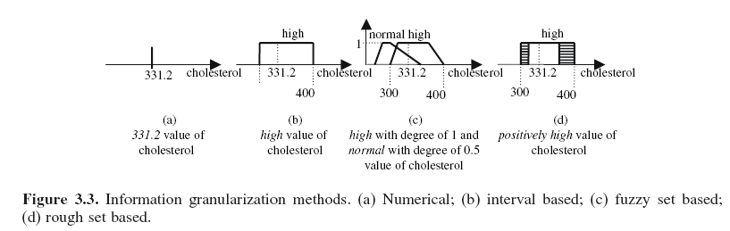
Imprecise Data
Real data often include imprecise data objects
  for instance, we may not know the exact value of a given test, but know whether the value is high, average, or low
  in such cases fuzzy and/or rough sets can be used to process such information: INFORMATION GRANULARITY

Slide 47
Incomplete Data
Def.: Data that does not contain enough information to discover (potentially) new knowledge
  for instance, when analyzing heart patient’s data if one wanted to distinguish between sick and healthy patients
  but only demographic information was given it would be impossible to do it

Slide 48
Incomplete Data
  In case of incomplete data we first need to identify the problem and take some corrective measures
    to detect incompleteness the user must analyze the existing data and assess whether the features and objects give sufficiently rich representation of the problem
      if not we collect additional data (new features and/or objects)

Slide 49
Redundant Data
Def.: Data containing two or more identical objects, or when features are strongly correlated
  redundant data is often removed, but in some cases the redundant data contains useful information, i.e., frequency of the same objects provides useful information about the domain
  a special case is the irrelevant data, where some objects and/or features are insignificant with respect to data analysis
    e.g., we can expect that patient’s name is irrelevant with respect to heart condition
  redundant data are identified by feature selection and extraction algorithms and removed

Slide 50
Missing Values
Many data sets are plagued by the problem of missing values
  missing values can be a result of manual data entry, incorrect measurements, equipment errors, etc.
  they are usually denoted by special characters such as:
  NULL
  *
  ?

Slide 51
Missing Values
Are handled in two ways:
  removal of missing data
    the objects and/or features with missing values are discarded: can be done only when the removed objects features are not crucial for analysis (e.g., in case of a huge data set)
    practical only when the data contain small amount of missing values
      for example, when distinguishing between sick and healthy heart patients, removing blood pressure feature will result in biasing the discovered knowledge towards other features, although it is known that blood pressure is important

Slide 52
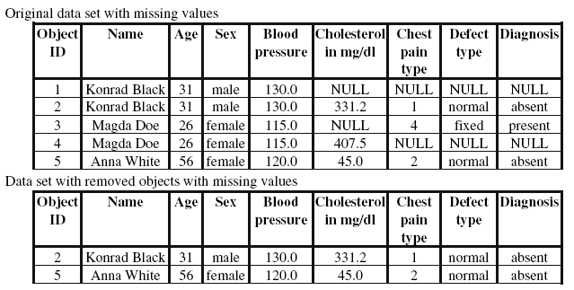

Slide 53
Missing Values
Are handled in two ways:
imputation (filling-in) of missing data
  performed using
    single imputation methods, where a missing value is imputed by a single value
    multiple imputations methods, where several likelihood-ordered choices for imputing the missing value are computed and one “best” value is selected

Slide 54
Missing Values
single imputation
  mean imputation method uses the mean of values of a feature that contains missing data
    in case of a symbolic/categorical feature, a mode (the most frequent value) is used
    the algorithm imputes missing values for each attribute separately
    it can be conditional or unconditional
      the conditional mean method imputes a mean value that depends on the values of the complete features for the incomplete object

Slide 55
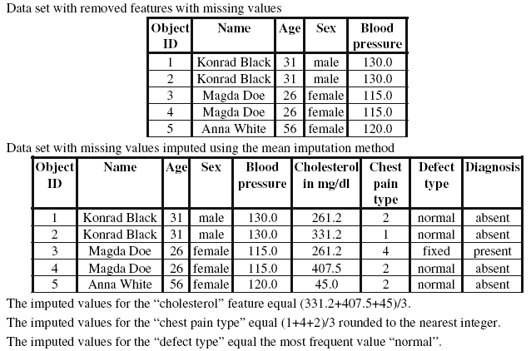

Slide 56
Missing Values
- single imputation
  hot deck imputation: for each object that contains missing values the most similar object (according to some distance function) is found, and the missing values are imputed from that object
    if the most similar record also contains missing values for the same feature then it is discarded and another closest object is found
      the procedure is repeated until all the missing values are imputed
      when no similar object is found, the closest object with the minimum number of missing values is chosen to impute the missing values

Slide 57
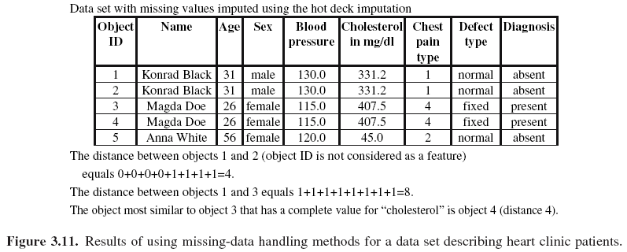

Slide 58
Noise
Def.: Noise in the data is defined as a value that is a random error or variance in a measured feature
  the amount of noise in the data can jeopardize the entire KDP results
  the influence of noise on the data can be prevented by imposing constraints on features to detect anomalies when the data is entered
    for instance, DBMS usually provides facility to define constrains for individual attributes

Slide 59
Noise
Noise can be removed using
  Manual inspection with the use of predefined constrains on feature values
    and manual removal (or change into missing values) of all values that do not satisfy them
  Binning
    Requires ordering values of the noisy feature and then substituting the values with a mean or median value for predefined bins
  Clustering
    it finds groups of similar objects and simply removes (or changes into missing values) all values that fall outside clusters

Slide 60
Noise
Noise can be removed using
  clustering
cholesterol
400
300
200
100
0
cluster
potential outlier (noise)
20 30 40 50 60 70
age

Slide 61
References
Holsheimer, M. and Siebes, A. 1994. Data Mining: The Search for Knowledge in Databases, Report CS-R9406, ISSN 0169-118X, CWI: Dutch National Research Center, Amersterdam, Netherlands
Ganti, V., Gehrke, J. and Ramakrishnan, R. Aug. 1999. Mining Very Large Databases, IEEE Computer, 32(8):38-45
Klosgen, W. and Zytkow, J. (Eds) 2002. Handbook of Data Mining and Knowledge Discovery, Oxford University Press
Shafer, J.L. 1997. Analysis of Incomplete Multivariate Data, Chapman and Hall

